Slide 1

















Slide 2













Slide 3
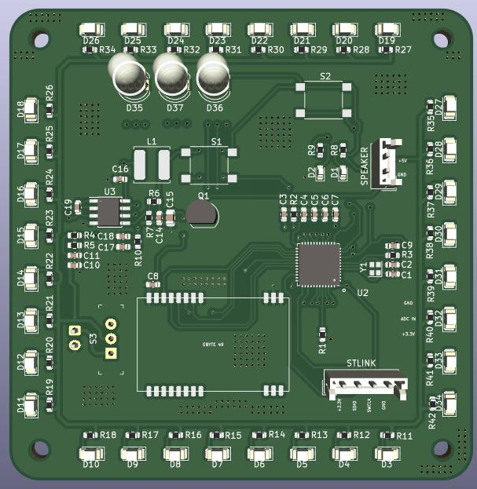
RGB LEDs
Button 1 (General Purpose)
Button 2 (General Purpose)
Buck Converter (converts 5V to 3.3V)
LEDs (on the side of the board)
Speaker/Buzzer
STLINK (code upload)
RF Tranceiver
5V connector
Switch (Turn on and turn off the board)

Slide 4


